Slide 1
New Hampshire State Leadership Conference
SHRM as a Resource
2014 Leadership Conference
Phyllis Shurn-Hannah, SPHR
SHRM Northeast Field Services Director (FSD)

Slide 2
Important Dates & Deadlines
Mark Your Calendars!
November 20 - 22, 2014
SHRM Leadership Conference
December 1
CLIF & SCLIF due
December 31
Deadline for receipt of SHRM Foundation donation for 2014
January 31
Chapter SHAPE Year-End Report due
January 31
State Council SHAPE Year-End Report due

Slide 3
SHRM Volunteer Leadership Summit
November 2014 20 – 22, 2014 At “New” Marriott Marquee, Washington, DC
Eligible Volunteer Leaders:
Target audience is the incoming chapter presidents and incoming State Directors , State Membership Directors, CMP’s., and State District Directors,
New! State Certification Directors (2014)
EVERY chapter should be represented EVERY year
FREE for eligible attendees listed above; includes hotel, designated meals and conference registration; chapter pays travel expenses
If the incoming president cannot attend, the president-elect for the next year may attend in his/her place
Attendance is tied to SHAPE award levels
The 2014 SHAPE workbooks are available online

Slide 4
Chapter Leader Information Form (CLIF)
Due December 1
Online form for your chapter to submit complete board/volunteer roster
Due by 12/1, even if you don’t have all roles filled by then
List those roles you know, and provide remaining volunteer list later
Required for all chapters
Allows SHRM to keep in touch with your board members to announce new tools, webcasts, etc.
Must submit on time to qualify for any award for the year

Slide 5
Bylaws
MUST BE FOLLOWED
All board members should carefully review the bylaws upon taking office and should follow them as a legally binding document
Bylaws model online – be sure your bylaws include all required sections as stated in the checklist online
ANY bylaws revisions need to be sent to your Field Services Director (FSD) for review
Two sets: original bylaws showing markups/changes and clean, final set for signature
ANY bylaws changes will then be approved by SHRM (including name changes and changes to 100%)
Do not plan your chapter membership vote until AFTER you have received the signed final copy from SHRM

Slide 6
Bylaws Approval Process
May take 6-8 weeks, depending on schedules of approvers
E-mail the complete set of bylaws (marked-up copy and final copy) with a bulleted list of the changes to your Field Services Director (FSD). They will review them and provide suggestions or changes.
Once they are approved by the FSD, the bylaws are approved by the Divisional Director and then the VP of Membership.
SHRM signs the bylaws, and then your Regional Administrator (RA) will send them back to you via e-mail.
Once you receive the signed bylaws, your chapter membership can then vote on the changes. Once they are approved, your chapter president should sign and date the bylaws and send the signed set back to your RA. The final signed version is placed into the files at SHRM.
This final set is considered to be RATIFIED. They are kept on file at SHRM.

Slide 7
Chapter Charters
Every chapter has one
These documents spell out the relationship between SHRM and chapters
Who owns membership lists
Correct use of the SHRM logo
Correct use of the SHRM name (don’t call your chapter or council SHRM)
Be sure your chapter has a copy; review it annually
If your copy is lost, contact your Regional Administrator

Slide 8

SHRM Affiliate Logo
Appropriate Use
Place prominently on all materials produced by an affiliate of SHRM.
Do not modify the logo; must be the entire “Affiliate of” logo, and never be smaller than 1-inch wide.
Use in conjunction with your chapter logo –- same size and near each other
Place it “above the fold” on website
If SHRM is part of your chapter name, your chapter logos must be approved by SHRM

Slide 9
SHRM Requirements
SHRM bylaws require chapter presidents and all state council members be active SHRM members throughout the duration of their term.
Must be indicated in chapter bylaws.
SHRM encourages chapters to require all board members to be SHRM members for greater synergy in the affiliation relationship.
Effectively lead chapter or state council throughout the year and mentor president-elect for upcoming year.
Assure bylaws are being followed.
Attend and actively participate in state council meetings.

Slide 10
SHRM Requirements
New chapter affiliation requirements as of January 1, 2012:
All 100%-Chapters
Minimum of 25 SHRM members AND
100% SHRM membership
All Non-100% Chapters
Minimum of 25 SHRM members AND
Minimum of 51% SHRM membership
Applies to all existing and new chapters - no grandfathering.
Chapters not currently meeting new affiliation requirements will have a five year period (by 12/31/2016) to do so.
Regional Team is working with under-affiliated chapters to ensure successful transition to new requirements (Fortune Forty Team).

Slide 11
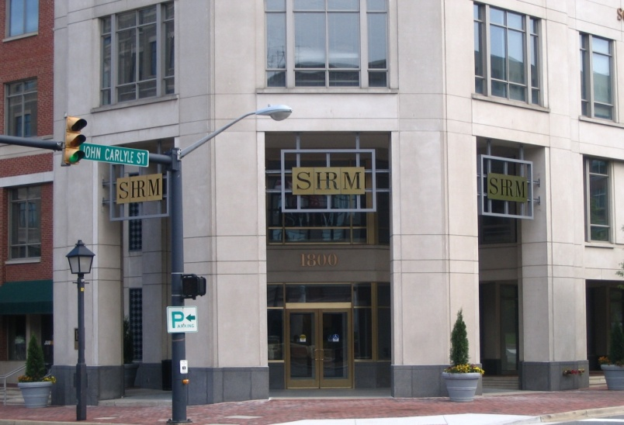
About SHRM
The parent organization
Founded in 1948
World’s largest professional association dedicated to HR
Headquartered in Alexandria, VA
About 350 staff members
About 270,000 professional and student members in more than 140 countries
More than 575 affiliated local chapters
Over 6,000 volunteer leaders

Slide 12
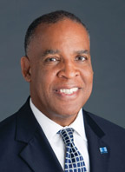

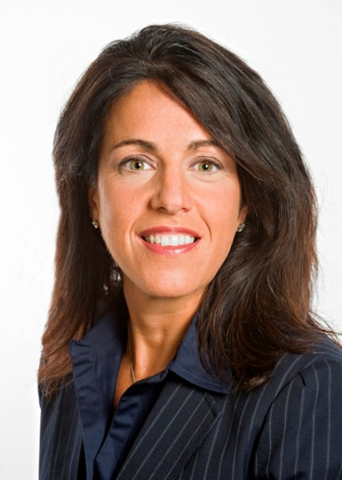
SHRM Staff Leadership
Henry (Hank) Jackson, CPA
President/CEO
Robert Carr, JD, SPHR
SVP of Membership, Marketing and External Affairs
Elissa O’Brien, SPHR
VP of Membership

Slide 13
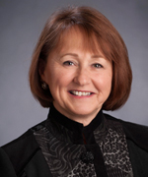
SHRM Board Chair
Bette J. Francis, SPHR
2013-2014
SHRM Board Chair

Slide 14
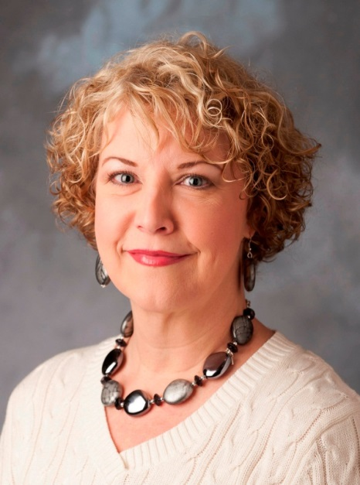
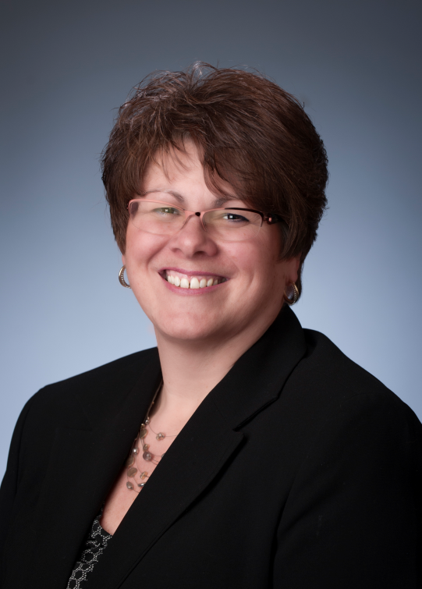
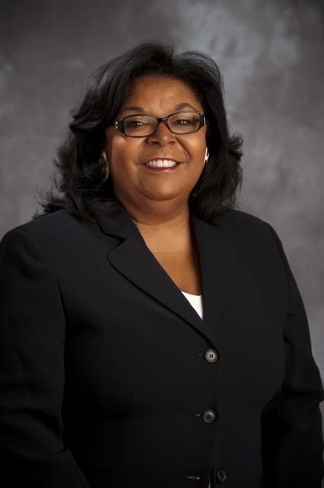
Northeast Regional Contacts -- 2013
Shelly Trent, SPHR
DE, MD
shelly.trent@shrm.org
(800) 283-7476, x 6335
(703) 535-6335
Susan Post, SPHR, CAE
NY, Divisional Director East
Susan.post@shrm.org
(800)283-7476 x6201
(703) 535-6201
Phyllis Shurn-Hannah, SPHR
CT, ME, MA,NH, NJ, PA, RI, VT
phannah@shrm.org
(800) 283-7476 x6335
(703) 535-6293
Notes:
And, serving as your emcee for the conference is …………

Slide 15
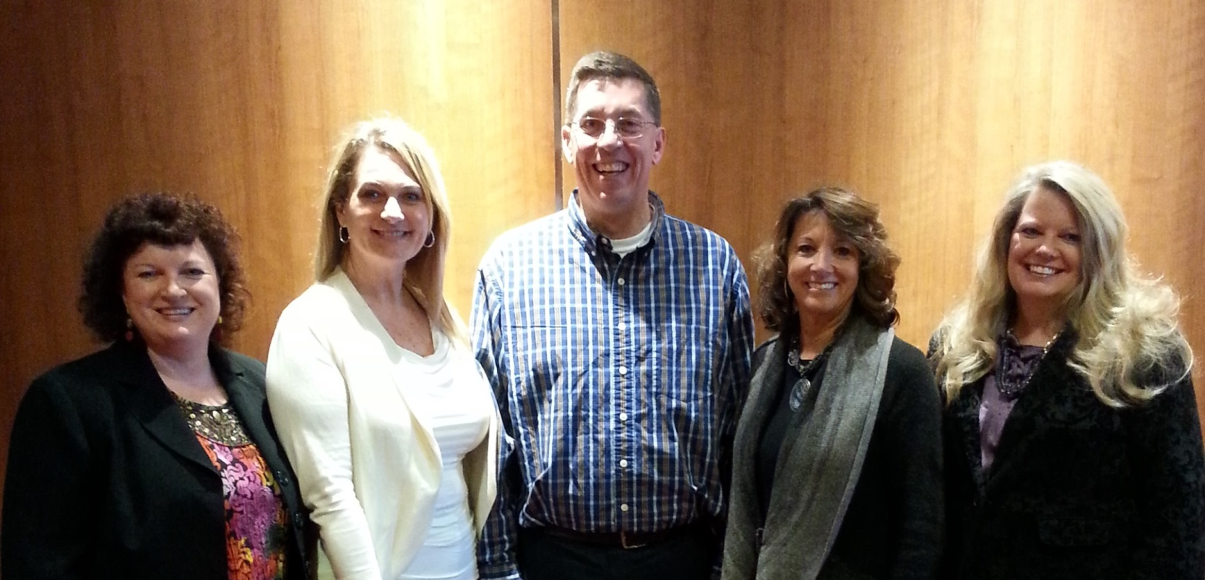
2014 Membership Advisory Council
Left to Right
Southeast Region: Paula Harvey, SPHR, GPHR
Southwest Central Region: Rebecca Briley
North Central Region: Steve Browne, SPHR
Pacific West Region: Debbie Horne, SPHR
Northeast Region: Kristine Avery, SPHR

Slide 16
SHRM’s Vision
SHRM will be a globally recognized authority whose voice is heard on the most pressing people management issues of the day – now and in the future.

Slide 17
SHRM’s Mission
Build partnerships
Provide a global community to share expertise & create innovative solutions
Provide thought leadership, education, & research
Be an advocate on the most critical issues facing workplaces & the human resource profession

Slide 18

SHRM’s Strategy
Continue to provide high-value resources to existing core membership
Be a global organization
Operate as a financially sustainable organization
Be the recognized thought leader on people management issues

Slide 19
Volunteer Structure
SHRM® Board
Governance Committee*
Membership Advisory Council
HR Expertise Networks
Ethics
Global
Labor Relations
Workplace Diversity
HR Technology
HR Disciplines – Includes:
Talent Management, Compensation, Benefits, Organizational Development, Employee Relations, Employee Health, Safety & Security
Regional Councils
Members
State Councils
Local Chapters
Staff Support
Notes:
SHRM is “profession-focused, member-driven, volunteer-led, and staff-managed.”
The very structure of SHRM and the involvement of the volunteer leaders support this position.
Each of these entities plays an integral part in the success of SHRM – let’s talk about each one in more detail.

Slide 20
Core Leadership Areas
Each state council is asked to have the following positions:
College Relations
Diversity
Governmental Affairs
HR Certification Institute Certification
Membership
SHRM Foundation
Workforce Readiness
Chapters should consider these board roles as well

Slide 21
Expectations of Volunteers
Chapter Presidents should attend all state council meetings or send substitute/proxy
Please READ all correspondence from your State Council, District Directors, and from your Regional Team
Please ask your company to allow e-mail messages from SHRM, your Regional Team and council members
If you ever opted out of any SHRM e-mails, you will not receive volunteer e-mails until you opt in again
E-mails from SHRM Volunteer Communications and the monthly SHRM Update are our MAIN point of communication with you – please read them

Slide 22
Volunteer Assistance
There are administrators at headquarters with a general number to call: (800) 283-SHRM x 3333; 7 a.m.-7 p.m. ET. Anyone at that number can assist you with CFSP, rosters, designation forms, etc.
The number will take voicemails 24/7 but will only be manned from 7 a.m.-7 p.m. ET.
E-mail: SHRM.MemberRelations@shrm.org. This is a generic e-mail inbox that will be accessible by all the Regional Administrators.
Order SHRM supplies from your Regional Administrator.

Slide 23
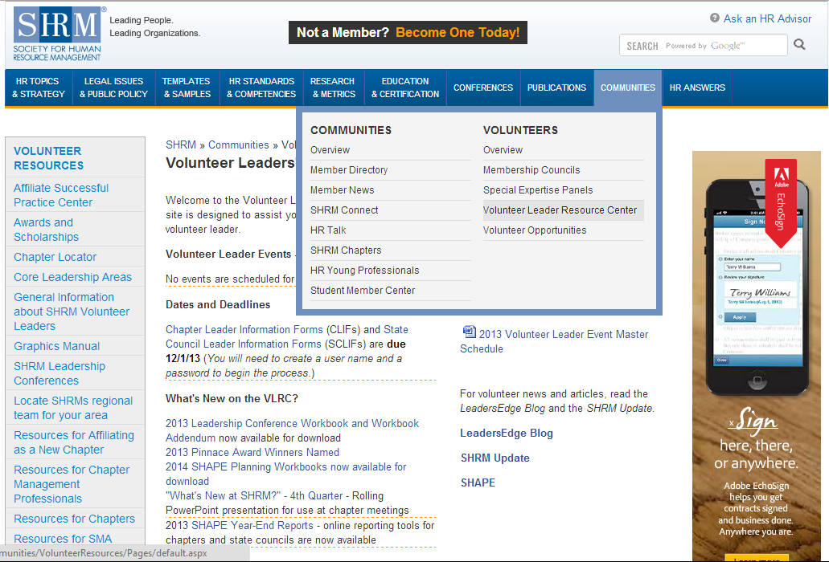
Volunteer Leader Resource Center (VLRC)
www.shrm.org/vlrc

Slide 24
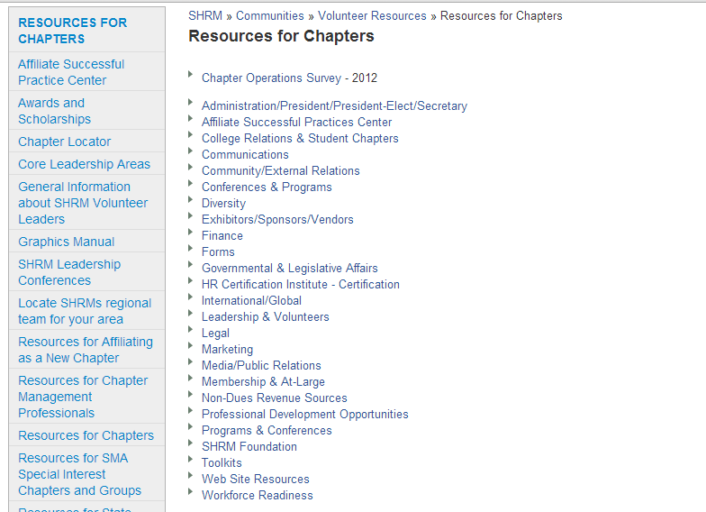
VLRC: Resources for Chapters
Survey data from chapters about dues, programs, etc.
Resources for every volunteer role – don’t reinvent the wheel!

Slide 25
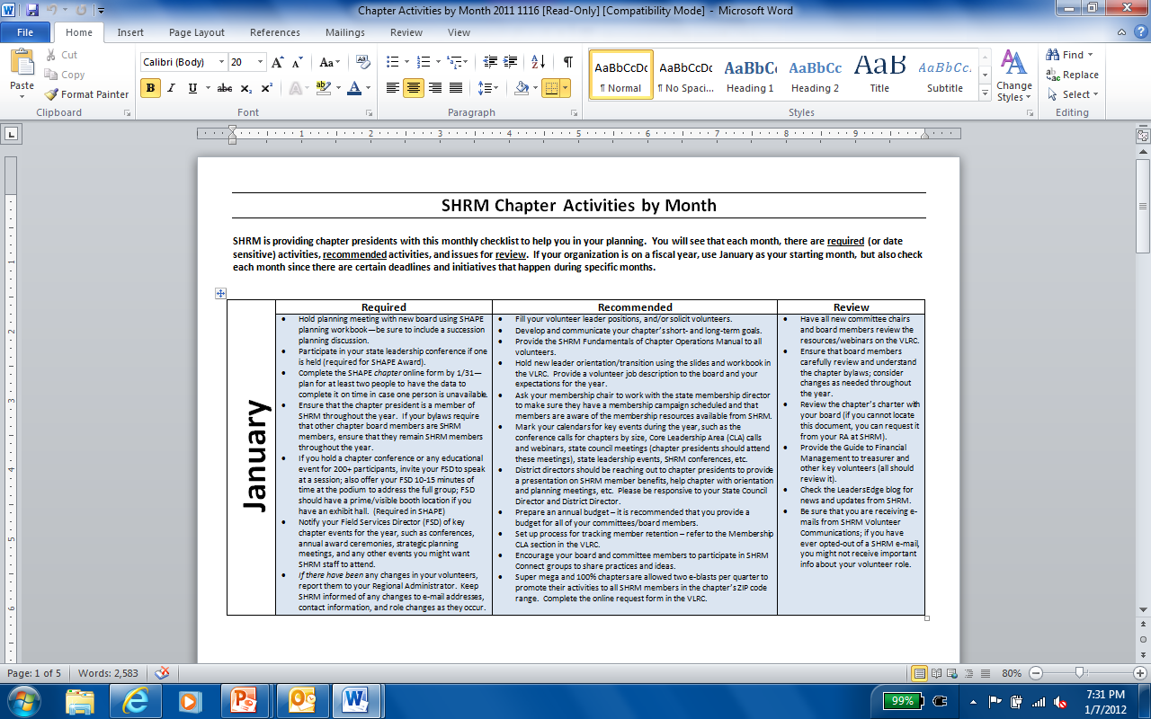
VLRC: Chapter Activities Checklist by Month
Under Administration/President . . .

Slide 26

VLRC: Chapter Leader Resource Guide
Under Administration/President . . .
All volunteers on your board should have a copy and review it carefully
Contains info on: Staff contacts, governance and bylaws, incorporation, membership rosters, affiliation requirements, using e-blasts, chapter operations, and much more
Download from VLRC at www.shrm.org/Communities/VolunteerResources/ResourcesforChapters/Documents/Fundamentals_of_Chapter_Operations_12-0642.pdf

Slide 27

VLRC: Membership Recruitment & Retention Toolkit
Under Membership CLA
Contents:
Recruitment
Why HR professionals don’t join chapters (survey results) Determining key prospects
Setting Your strategy
Marketing materials, Tools, Templates and resources available from SHRM
Retention
Defining retention
The Cost of retention
Continuous marketing
The renewal process
Determining why members don’t renew
PLUS: Customizable letter templates, scripts, talking points, surveys, and calculations

Slide 28

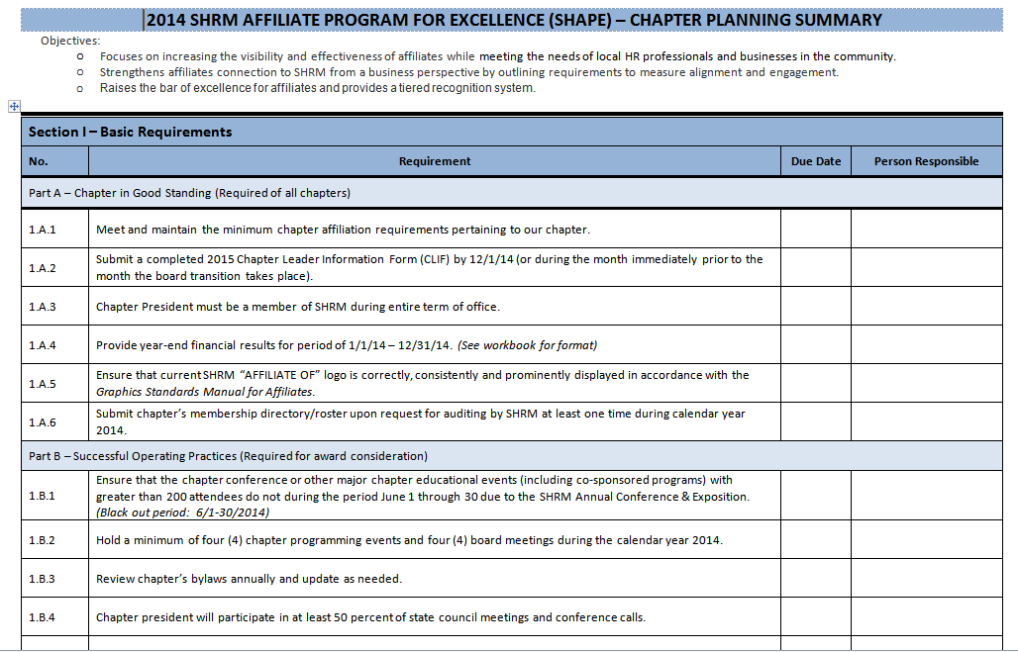
SHRM Affiliate Program for Excellence
SHAPE
Both a planning tool and an evaluation tool
Covers calendar year
Reporting tool for SHAPE award
Must be filed with SHRM by 1/31 to receive CFSP
Need to determine now who will complete
Complete online only
2014 Planning book and worksheet available

Slide 29
SHAPE
Sections and Awards
Section 1: Basic Requirements (Must be completed by ALL chapters to remain affiliated)
Section 2: Community-Based Chapter Initiatives
Section 3: SHRM Affiliate Engagement
Section 4: Measures of Success
Appendix A: Resources
Appendix B: Sample Year-End Report Form
Four award levels: Bronze, Silver, Gold, and Platinum
You must have submitted your CLIF by December 1
to qualify for any SHAPE award

Slide 30
Membership
Member Definitions
At-large Members
At-large member is an individual who is a member of SHRM but is not affiliated with a local chapter.
Recruiting at-large members to your chapter is a great way to increase SHRM membership in your chapter.
Online membership application includes a required field for indicating chapter membership.
Local Members Only (LMOs)
An LMO is an individual who belongs to a local chapter but is not a SHRM member.
Promote benefits of joining SHRM to your LMOs.
Discount offered to first-time SHRM members via a promotional code (0118).
Strengthens partnership between SHRM and the chapter.

Slide 31
Membership
Member Definitions
Primary Members
Member of more than one chapter (multi-member) who designates one chapter as the primary chapter (this chapter receives CFSP for the member).
Multi-Members
Member of SHRM who maintains membership in multiple chapters. Primary chapter affiliation is with another SHRM affiliate chapter. A chapter would receive credit for chapter affiliation percentage purposes for multi-members but not for CFSP.

Slide 32


Membership Award Status
1% - 3.99%
STAR
4% or more
SUPERSTAR

Slide 33
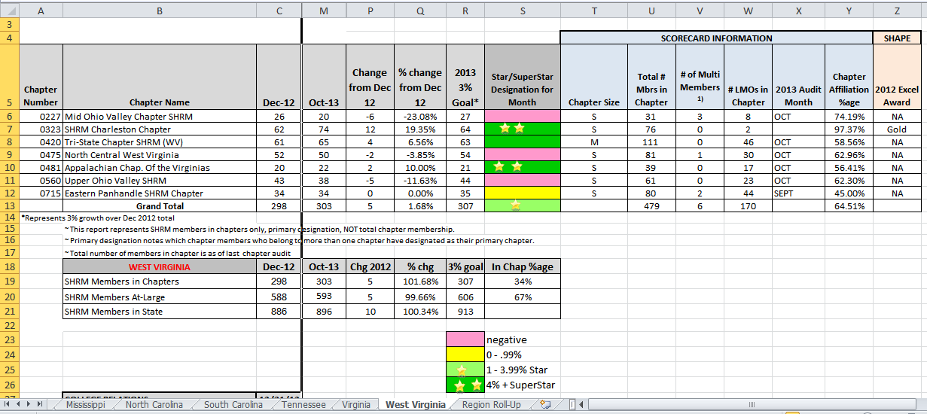
Monthly Membership Reports
Sent to State Council Directors, State Council Membership Directors, Chapter Presidents & CMPs
At the bottom of the report are tabs for each state in the region. Compare year-end numbers with current month. Also note member growth/loss and percent change. PLEASE NOTE that LMO numbers are captured only ONCE per year, during the audit. LMO numbers on this report will NOT CHANGE.

Slide 34
E-Blasts
Use them!
SHRM offers State Councils, Super Mega chapters, and 100% chapters the opportunity to reach at-large members via e-mail eight times per year (two per quarter)
Use online request form in the VLRC
SHRM sends the e-blast on your behalf and will make edits as necessary
State Councils also receive e-blasts for announcing the state conference to members in their own state

Slide 35
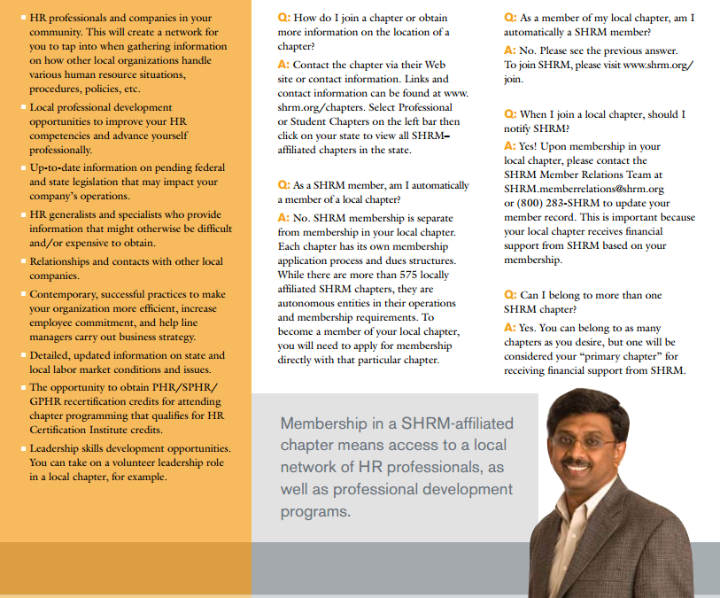
Chapter Affiliation Brochure
Brochure is free to chapters and downloadable to handout at meetings
Explains the value of chapter membership to SHRM members
Use it to contact at-large members to invite them to become chapter members

Slide 36
Membership Reports from SHRM
Chapters can request . . .
SHRM monthly or quarterly reports via an e-mail request with a set deadline
Current chapter roster
Full at-large list within chapter’s established zip code range
Expired SHRM members in the chapter
New at-large members list within the quarter
The roster requests will be distributed within 48 hours
SHRM will also provide sample e-mails/letters that the chapter can use for their benefit
These reports are NOT sent automatically, but can be requested
Membership chair should conduct at least quarterly audits comparing the SHRM at-large list, the SHRM in-chapter list, and the chapter’s roster. Send the RA any discrepancies.
Send list of your new/expired members
to SHRM each month

Slide 37

Conducting Membership Audits
SHRM uses the member roster sent by your chapter to conduct audits on an annual basis
Please send chapter membership roster upon request—the more current, the more accurate the audit
Please note that SHRM conducts only ONE audit per chapter per year.
Other audits can be conducted by volunteers and changes shared with SHRM throughout the year.

Slide 38
Primary Designation Forms
Primary Chapter Designation Form submission deadline – NEW!
From January – November, CDFs must be received by the 5th business day prior to the end of the month to be processed.
For December, must be received by December 15th to be processed by the end of the year.
While a SHRM member may belong to more than one affiliated chapter, only one chapter may be designated as that member's primary chapter. The member is free to change that designation as he/she wishes. Primary Chapter Designation Forms are signed directives from the member to SHRM authorizing SHRM to change his/her primary chapter designation.
The form is completed by the member and faxed or emailed to SHRM. Upon receipt of the executed form, the member's primary chapter will be changed. To ensure changes are made during the appropriate month, submission deadlines are in place.

Slide 39
In-Transition Membership
Please share with your members
SHRM offers a one-time-only benefit of a free one-year continuation of membership to any current member who has been downsized
Must already be a member of SHRM
Contact SHRM’s Member Care Department for more information
Consider offering this option to your own members – great for retention!

Slide 40


The New SHRM Credentials
We believe these new credentials will become the
globally-recognized standard of excellence in HR.
We’ve created the SHRM-CP and SHRM-SCP to:
Encourage HR professionals to acquire the knowledge and behaviors required for effective performance and career success;
Establish a certification that is highly relevant to employers, and meets the needs of business;
Grow certification in the HR profession; and
Create a new and universal standard for HR.
Notes:
There are two credentials associated with SHRM’s new certification: the SHRM Certified Professional (SHRM-CP) and the SHRM Senior Certified Professional (SHRM-SCP).
The SHRM-CP and SHRM–SCP encourage HR professionals to acquire the knowledge and behaviors they’ll need to effectively perform their jobs and that lead to career success. This certification program was built with employers in mind, will help set the global standard for excellence in HR, and aims to grow certification throughout the HR profession.

Slide 41
Key Features of Certification
Competency-Based
Universal
Expanded Access
Streamlined Recertification
Integrity & Best Practices
Pathway to SHRM-CP & SHRM-SCP
Notes:
SHRM is incorporating important advantages in every aspect of the new certification program.
The SHRM certification is competency-based, has a universal Body of Competency and Knowledge, will increase access to certification across the HR profession, has a streamlined recertification process, establishes a pathway to acquiring the new credentials, and was developed using industry best practices.
We will go over each of these areas in the remaining slides.

Slide 42
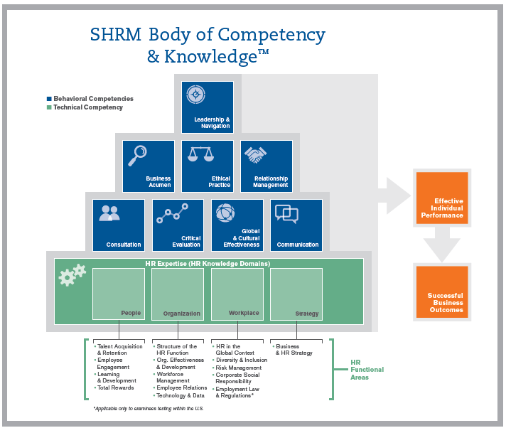
SHRM BoCK
Notes:
SHRM BoCK is based on 8 behavioral competencies and 1 technical competency (HR expertise) which is made up of 4 knowledge domains and 15 functional areas.
Programming in any of these areas will be eligible for PDCs. Broadening the scope of eligible recertification activities will help individual HR professionals strengthen their core skills, while contributing to a stronger HR profession

Slide 43
Testing for Competencies
The SHRM-CP and SHRM-SCP exams will include a combination of
knowledge-oriented and competency-based questions.
The exam will be 130-150 questions and will take approximately 3 hours to complete.
SJ items describe a scenario and provide a variety of behavioral-based approaches to resolving the issue; examinees are asked to select the most appropriate approach; several questions may be based on the same scenario
SJ exams are proven in measuring competencies
SJ exams are a well-established, valid approach to assessment
SHRM is partnering with a premier test development organization with deep expertise in the development of SJ-based exams
Notes:
The exam will be 130-150 questions, and will contain both knowledge- and competency-based questions. We anticipate that the exam will be approximately 3 hours.
The SHRM certification exam will be taken at a Prometric testing center.
Competencies can be tested by using situational-judgment questions, which are a well-established and valid approach to assessment.
We can use situational-judgment testing to measure not only what you know, but how you apply that knowledge in the situations you face every day.
Situational-judgment questions describe a scenario and ask examinees to select the most appropriate approach in response to that scenario.
SHRM has partnered with a premier test development organization whose expertise is in crafting situational-judgment questions.

Slide 44
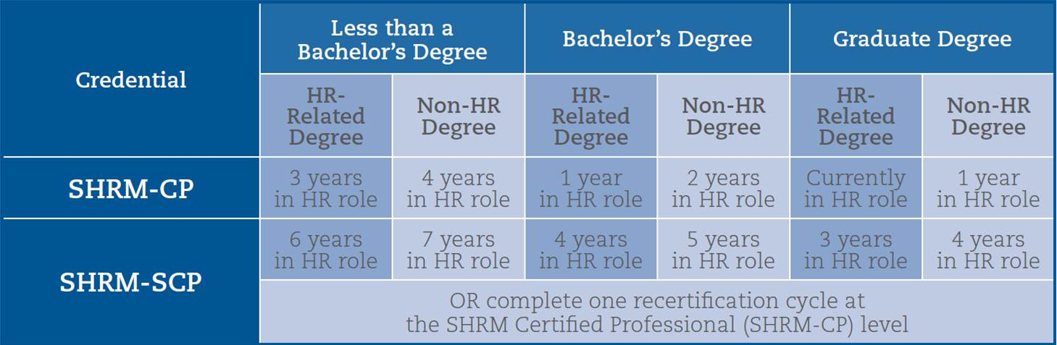
Eligibility Requirements
The SHRM certification program recognizes the value of formal HR education,
makes certification accessible to professionals with less-than-full-time work arrangements,
and provides a pathway from SHRM-CP to SHRM-SCP.
Notes:
SHRM is increasing access to certification for HR professionals.
SHRM recognizes the value of having a formal HR education in the eligibility requirements.
Makes certification accessible to professionals with less-than-full-time work arrangements
1,000 work hours in an HR role in a calendar year = 1 year of experience
Exempt and non-exempt status will no longer effect whether you can take the certification exam.
The certification program also provides a pathway from SHRM-CP to SHRM-SCP.
The chart shows the eligibility requirements needed to take the exam, based off a combination of work and educational experience.

Slide 45
Recertification Credits
Category | Description/Examples | Maximum Number of Professional Development Credits (PDCs)
Advance Your Education | Continuing education such as: Conferences College courses Seminars e-Learning Chapter programs Webcasts Audiocasts Podcasts | No maximum for instructor-led PDCs Maximum of 30 credits for self-paced PDCs
Advance Your Organization | Work projects endorsed by supervisor which support organizational goals and advance or demonstrate capabilities in one or more HR competency. | Maximum of 20 PDCs per cycle
Advance Your Profession | Thought leadership and volunteer activities such as: Professional membership Chapter leadership Speaking at conferences Writing and Research | Maximum of 30 PDCs per cycle
Notes:
The 60 professional development credits needed in order to recertify can be earned in the following categories: advancing your education, advancing your organization, and advancing the profession.
The chart above provides examples for the types of activities that can be done, as well as the maximum number of credits allowed per each category.
There is no minimum threshold of credits required in any of the three categories.
Examples of self-paced continuing education activities include: webcasts, eBooks, videoconferences, audio casts, podcasts, asynchronous e-learning activities, etc.

Slide 46


D
SHRM
Preferred Provider Program for
Chapters and
State Councils
Devon Conley
Human Resources Manager
SHRM member since 2005
Notes:
[Introduction – Speaker should tell the audience a bit about their background, their credentials, their role at SHRM]
This is an exciting and pivotal time in our profession. Now, more than ever, HR teams are required to assume a greater leadership role, contributing to the strategic direction of their organizations. The profession is no longer just about what you know – but how you do your job.
SHRM has been monitoring this shift and as you know, launched the SHRM certification in May of this year.
We believe the SHRM certification will become the new standard for HR professionals around the globe, as it is among the first HR certifications that is focused on teaching and testing the practical, real-life information HR professionals need to excel in their careers today, including knowledge, skills and competencies.
This presentation will be an overview of the SHRM certification and will answer any questions you may have.

Slide 47

SHRM Chapters/State Councils SHRM Preferred Provider Eligibility
SHRM Chapters and State Councils will be eligible to become SHRM Preferred Providers
if they are “In Good Standing”
There is NO COST for eligible SHRM Chapters and State Councils to participate in the
SHRM Preferred Provider program
Notes:
The first step to certification is achieving a SHRM Certified Professional or a SHRM Senior Certified Professional credential

Slide 48
1. A SHRM Chapter or State Council must maintain “in good standing” status. 2. A SHRM Chapter or State Council must designate a contact person who will be responsible for entering relevant educational activities into the online SHRM program database. 3. A SHRM Chapter or State Council must have the resources, facilities, and administrative support to effectively deliver HR-related Competency and/or Knowledge programming. 4. A SHRM Chapter or State Council must offer appropriate high-quality programming, developed and presented by appropriate subject matter experts. 5. Programming should address the HR Competencies and/or Knowledge Domains needed for effective job performance, as outlined in the SHRM Body of Competency and Knowledge (SHRM BoCK- available at www.shrmcertification.org). 6. Each eligible program offering must describe both learning objectives and Competencies/ Knowledge areas to be taught, with specific references to the SHRM BoCK. 7. Each presenter/instructor/speaker must have proven expertise in the field and the ability to facilitate learning. 8. A SHRM Chapter or State Council must have a participant evaluation process in place and utilize feedback to ensure continuous improvement in program content & quality.
Qualifications
Notes:
Be sure you have the appropriate facility and you have your program folks really watching and being aware of the requirements for high quality programming.

Slide 49
As a SHRM Preferred Provider, SHRM Chapters and State Councils must adhere to the following: 1. Award Professional Development Credits (PDCs) for individual program offerings. 2. Use SHRM methodology to award the appropriate number of PDCs for individual offerings. Credit is awarded based on the actual educational time spent in the program. Examples: ›› 1-hour educational program = 1 PDC ›› 1-hour and 15 minute concurrent conference session = 1.25 PDCs ›› 3-hour e-learning course = 3 PDCs 3. Include a process for determining attendee participation for passive-format programs (e.g. webinars, videoconferences, audiocasts, self-directed e-learning). 4. Ensure qualifying programs are at least one hour (e.g. 45-minute presentation with 15 -minute Q&A period). 5. Have a SHRM-CP or SHRM-SCP be part of the program review process by the end of 2015. 6. Adhere to SHRM marketing guidelines when using the SHRM logo and/or any program seals 7. Provide program participants with verification of attendance (e.g., certificate of completion, e-mail notification, materials distributed on site) that show the number of PDCs assigned to the educational activity. 8. Comply with any audits conducted by SHRM.
Program Guidelines

Slide 50
Registration Process
SHRM Preferred Provider registration process for Chapters and State Councils
Email invitation with registration link will be sent out in mid-September inviting eligible Chapters and State Councils to participate in the SHRM Preferred Provider Program.
Chapters and State Councils must confirm intent to participate in the SHRM Preferred Provider program and acknowledge adherence to all program qualifications and guidelines.
Chapters and State Councils must identify Program Contact Person via the online SHRM program database.
Upon completing the above process confirmation of SHRM Preferred Provider status will be emailed to the contact person.
Once SHRM Preferred Provider database is live in late November, contact persons for Chapters and State Councils will be able to begin adding programs.

Slide 51

SHRM Foundation
Why Support the Foundation?
Conducts and funds research on HR topics
Is supported by tax-deductible donations from SHRM members
Supports scholarships, SHRM chapter educational matching grants and other educational initiatives
Toolkit available for chapter/state Foundation chairs at www.shrm.org/foundation
Provides a DVD series that can be used for chapter programs; pre-approved for credit

Slide 52
SHRM Foundation DVD Series
Pre-approved for HRCI credit as Chapter Program
NEW! From Local to Regional to Global Player: The Evolution of Aramex International
Dollar General: Serving Others--Dollar General's Commitment to the Military Community
Ernst and Young: Creating a Culture of Flexibility (General credit)
Doing Well by Doing Good: Global Sustainability at Aditya Birla Group (Strategic or International credit)
Once the Deal is Done: Making Mergers Work (Strategic credit)
World Economic Forum: Creating Global Leaders (Strategic or International credit)
Seeing Forward: Succession Planning at 3M (General credit)
Trust Travels: The Starbucks Story (Strategic credit)
Ethics- The Fabric of Business (Strategic credit)
Fueling the Talent Engine-Finding and Keeping High Performers(Strategic credit)
HR in Alignment: The Link to Business Results
HR Role Models
www.shrm.org/about/foundation/products/Pages/SHRMFoundationDVDs.aspx

Slide 53

SHRM Foundation Champion
For the SHAPE
To achieve the Foundation's Champion designation, your chapter or state council must
Make a monetary contribution to the annual campaign from your chapter's or state council's funds
Conduct a Leadership Campaign by encouraging your chapter or state council officers / board members to make a personal donation to the SHRM Foundation, with the goal reaching 100% participation.
AND one or both of the following:
Increase by 10% or more the chapter’s or state council’s monetary donation to the SHRM Foundation over the previous year’s donation
Hold at least one special fundraising event (e.g., silent auction, golf tournament, etc.) to benefit the SHRM Foundation

Slide 54

Chapter Financial Support Payments (CFSP)
The CFSP Program returns a portion of each SHRM member’s dues to the chapter through this program.
To be eligible for CFSP consideration, the chapter must:
Submit a completed SHAPE Year-End Report by 1/31 of each year and your membership roster when requested
Meet the applicable membership affiliation requirements.
Have a chapter president who is a SHRM member in good standing throughout his/her term of office.
Have SHRM-approved ratified bylaws on file at SHRM.
Have the payment direct-deposited.

Slide 55
Chapter Financial Support Payments (CFSP)
SHRM pays chapters and councils several million per year in financial support
Pays each state council a minimum of $3000- $1.00 per year based on SHRM membership in state – no longer capped!!!
The Chapter Financial Support Payment (CFSP) Program returns a portion of each professional (non-student) SHRM national member's dues to the chapter via a quarterly payment for 100% chapters (those chapters who require all members to be members in good standing of SHRM) or a twice-a-year payment for non-100% chapters.

Slide 56
Chapter Financial Support Payments (CFSP)
Example:
Chapter’s
12/31 SHRM Membership Count
2013 250
2012 -200
Difference 50
Net Gain Payment (50 X $25) = $1,250

Slide 57

Governmental Affairs
www.shrm.org/advocacy
Site updated continuously
Most current legislative information—both federal and state
Take an active role in shaping laws that directly impact HR professionals!
Thomas Jefferson once said, “America is not governed by the majority, but by the majority of those who participate.”
Exercise your HR Voice by actively participating in the political process of government. Show your chapter members how to use the online tools to communicate with their legislators.
Online instructional video available www.shrm.org/Advocacy
Get involved in SHRM’s Advocacy Team! www.shrm.org/Advocacy/Pages/SHRMA-TeamVideo.aspx

Slide 58
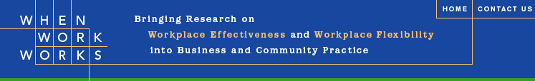
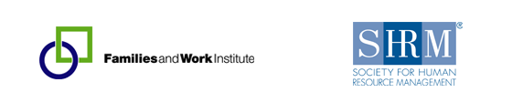
Governmental Affairs
When Work Works
Research on Effective and Flexible Workplaces
Guide to Bold New Ideas
www.shrm.org/communities/volunteerresources/pages/whenworkworkstoolkit.aspx

Slide 59

SHRM Pinnacle Award
Awarded to chapters and state councils at Annual Leadership Conference
Examples:
Assisting community members with welfare to work
Improving community diversity or work/family issues
Teaching job-search skills to the unemployed
Impacting local, state, or federal legislation
Corporate sustainability
Not limited to these!
$1,000 award and recognition in SHRM publications
See what other volunteers have done in the Pinnacle Compendium in the VLRC
SEPTEMBER 9TH DEADLINE!!!

Slide 60


Questions & Comments

Slide 61


Slide 62

Phyllis Shurn-Hannah, SPHR
Field Services Director
phannah@shrm.org
1-800-283-7476, Option 1, Ext. 6293

